Slide 1
“Slip or Trip”
Backing interpretations of evidence with
general rules (Warrants)

Slide 2
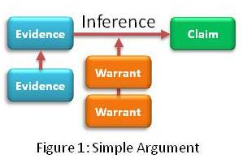
Interpreting Evidence
According to Webster:
war·rant (noun)
: a reason for thinking, deciding, or doing something

Slide 3
When asked to provide a warrant...
You are being asked to explain the general rules of life/the world or previous knowledge that lead you to your conclusion or claim.
Example:
It’s going to rain. →
Dark Clouds, cool moist air, compost smell
As a general rule, when there is a combination of dark clouds, extra moisture in the air, and an atmospheric smell, it rains.
→
(Claim)
(Grounds)
(Warrant)

Slide 4
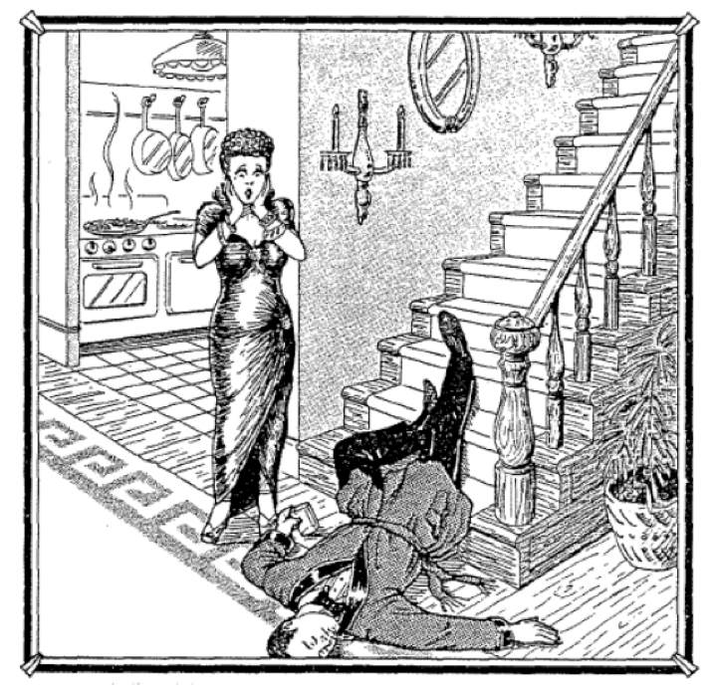
Is Queenie Telling the Truth?
At ﬁve-feet-six and a hundred and ten pounds, Queenie Volupides was a sight to behold and to clasp. When she tore out of the house after a tiff with her husband, Arthur, she went to the country club where there was a party going on.
She left the club shortly before one in the morning and invited a few friends to follow her home and have one more drink.
They got to the Volupides house about ten minutes after Queenie, who met them at the door and said, “Something terrible happened. Arthur slipped and fell on the stairs. He was coming down for another drink—he still had the glass in his hand—and I think he’s dead. Oh, my God—what shall I do?
The autopsy conducted later concluded that Arthur had died from a wound on the head and conﬁrmed that he’d been drunk.

Slide 5
Is Queenie Telling the Truth?
Do you think Queenie is telling the truth?
(Write down your claim- “Queenie is…”)
What evidence may conflict with Queenie’s story?
(Write down one piece of evidence from the picture)
What warrant, or general rule, lead you to this interpretation of the evidence?
(As a rule, when….)

Slide 6
In groups, collect evidence from image and text.
Evidence | Rule (Warrant) | Conclusion
 | As a rule, when...

Slide 7
Homework
Write an Argumentative Paragraph: Using the Toulmin Model, form an argument against or for Queenie’s innocence.
Label each element of your argument
Well-written
NO EMOTIONAL APPEALS

